Slide 1

Data Modeling for Beginners
UTOUG Training Days 2024
Notes:
Welcome! I am glad you chose to spend this hour learning about the basics of data modeling. I hope you find it was worth your time.
I don’t pretend to be a great speaker, but I’m passionate about doing data structure design right, up front, so that most of the friction and issues downstream goes away.
Show of hands… (do audience assessment)

Slide 2
Bill Coulam
Consultant and employee from coast to coast for over 25 yrs
  Telecom, energy, fitness, property insurance, healthcare, hedge fund, for-profit, non-profit, startups to Fortune 50
  Software engineer → data engineer, data modeler, data architect
  Currently senior data architect at FM Global in Rhode island (largest commercial property insurer in the world)
Speaker at Oracle conferences and local seminars since 2001
Notes:
This is me. I’ve been doing this for a long time. Started my career as a developer in the Bay Area just as the internet was exploding and was blessed to work on some very large databases, going through trials by fire, and learning a ton in the process.
I’ve worked in…
I’m currently…

Slide 3
Advise, Model, Train, Analyze, Tune and Fix DB’s
dbsherpa.com
bill.coulam@dbsherpa.com
https://www.linkedin.com/in/billcoulam/
Notes:
And now for the shameless plug.
I have a consultancy, where I’m happy to help or advise any of you or your friends with data modeling for relational or document databases, data architecture, MDM, performance tuning, etc.
I’m especially fond of performance challenges and making things scale and blazing fast. Happy to train anyone, but especially engineers and management in data fluency, data centricity, data management and change processes, etc.
If you have any questions that don’t get answered today, or need my help, you can reach me at this email address, or on LinkedIn

Slide 4
Agenda
Data Modeling 101
Let’s Practice!
Guiding Principles
Bonus Principles
Data Design Checklist
Notes:
We will probably only get through the top two items on the agenda here.
In the event we run out of time during the practice session, feel free to download this presentation from Sched later. My knowledge and spoken detail behind the Bonus Principles will be missing, but you can use the Data Design Checklist to get a nice head start on improving the practices of those who design data structures at your company.

Slide 5
Data Modeling 101
Notes:
Let’s now dive into the basics of data modeling

Slide 6

Data Modeling 101 - Relational Databases
Relational DBs are behind 60 to 80% of corporate systems
Relational data design involves “shredding” (or normalizing) the data into its atomic, indivisible pieces
Enables joining and composing result sets at runtime to satisfy ad-hoc queries
Makes high quality, complete and accurate data far more likely
Constraints (and good design) protect data integrity
Notes:
Document, graph, hierarchical, columnar, wide-column, and key-value databases all have a niche to fill. But relational databases are the swiss-army knife. For most organizations relational, transactional database are behind 60 to 80% of their systems. I prefer relational databases, especially now that the big players have made their systems multi-model, meaning they can serve as a JSON document, object, time series, or graph data store as well.
With a relational database, you break each collection of related information into small, independent, atomic components, like customer, address, account, account_type, order, order_item, item, item_part, etc. You are focused on, and designing for the sake of the data. This is also known as “shredding”, where the modeler simplifies, distills and teases apart the data into tables that represent real world things, classifications, and relationships between things. This is known as normalization. There are many benefits to this. One of them is being able to join the data “on read”, mixing and matching whatever data is needed to satisfy ad-hoc queries. The ability to answer new questions without having to re-organize the underlying data is very powerful. Another benefit is cleanliness. An authoritative piece of information (the “master”) is only kept in one place, not 3, 10 or 40 places. If the name of that thing, or one of its attributes changes, it only has to be changed in one place, because it is only linked by reference, using a foreign key to point from the child to the parent where all the master information on the parent is kept. If done right, data is clean and consistent and trustworthy, all the time.
NoSQL databases, particularly document databases, are mostly the opposite. The design of the document is focused on the needs of a single data access or query. This enables wicked fast writes and reads, but at the expense of duplication everywhere.
I’d like to introduce you to the basics of relational data modeling, and the steps within a mature enterprise-grade process for data modeling.

Slide 7
Data Modeling 101 - Design Process
Gather requirements and data knowledge
Identify entities
Identify attributes
Identify relationships
Identify cardinality and optionality
Identify keys, constraints and default values
Create and normalize conceptual & logical model
Document the entities and attributes
Notes:
The next two slides are the entire process.
If you can learn this well, and learn SQL, you can have a great career as a data analyst and modeler.
(click through points 1 to 8)

Slide 8
Data Modeling 101 - Design Process
Apply naming standard to the model(s)
Generate and augment the physical model
  Indexes, surrogate keys, denormalizations, audit columns
Check the model in. Publish link or copy for review.
Revise the model until consensus is reached
Implement the physical model DDL and test
Check the DDL into CI/CD folder
Publish model diagram and data dictionary
Notes:
(click through on points 9 to 15)
We’ll now touch briefly on each of these steps

Slide 9
Data Modeling 101 - Requirements & Knowledge
Be curious and ask questions, lots of them
Process, data flow, timing, rules, nullability, logging and retention
Keep digging
Notes:
Once the business analysis for the application is complete, we can proceed to design the data structures to hold the bits of information mentioned in the requirements and user stories.
Relational data design is the art and science of describing real world objects or concepts and how they are related to each other, in a manner that a computer can store and retrieve them accurately and efficiently.
Assuming you weren’t the analyst, reading through stories and requirements is like a gold-mining expedition; you are hunting for the entities, their attributes, the relationships and business rules between them.
But that is not all. In addition to the basic data elements, more questions will come to your mind about process, data flow and data usage that might not have been considered by the analysts. This is very much in keeping with the guiding principle of knowing your data well. This is where you really add value: when you seek clarity and ask questions to fill in gaps the analysts may not have considered. Questions like:
Can an order be cancelled before it has been submitted? What about after it has been submitted? If cancelling after submission is allowed, what rules determine when it is no longer cancellable? Can it be cancelled by someone who is not the person who submitted the order? What role must that person have to allow them to cancel by proxy? Do we have roles defined? And so on. And this is just scratching the surface of one attribute for one entity!!!
All of this discovery informs the data design, and often shores up the application design, future-proofing it to ensure it will satisfy the functional, quality, security, reliability and reporting goals of the business.
If you think you’re done, take a break and come back to it. You probably aren’t. Keep digging.

Slide 10
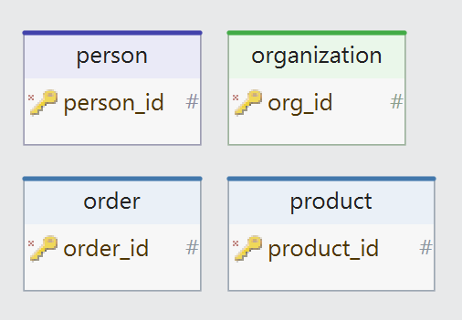
Data Modeling 101 - Entities
An entity is a real-world thing, person, location, event, or concept, about which the application will obtain, store and display information.
Person (User, Employee, Manager, Admin)
Organization (Company, Partner, Supplier)
Order
Product
Each entity becomes a table in the DB
https://vertabelo.com/blog/database-modeling-course-problem-set-1-identifying-entities/
https://vertabelo.com/blog/database-modeling-course-problem-set-2-identifying-entities-and-attributes/
Notes:
An "entity" is a real-world thing, person, location, event, or concept, about which the application will obtain, store and display information.
Read through the business requirements, looking for the key ideas, objects and elements that the system revolves around. An order-taking application will probably mention customer, salesperson, order, order items, product, payment and shipping information. These are the main entities of the new database.
As each key object is discovered, create a new box. If you are doing this in a group on the whiteboard, draw a box or even better, add a sticky note which can be repositioned later. When the entity is added to the modeling tool in a conceptual or logical diagram, be sure to document everything you discovered and know about it, in the entity comments section.
Once the model is implemented in an RDBMS engine, each entity becomes a table. Each distinct instance of an entity is a row in the table.

Slide 11
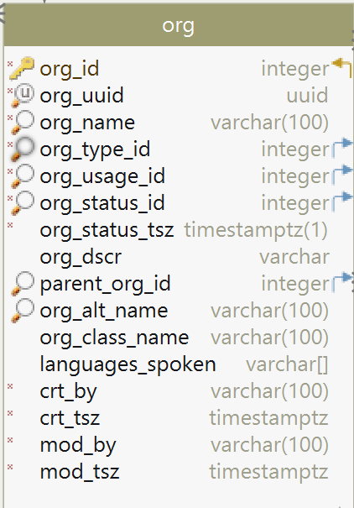
Data Modeling 101 - Attributes
An attribute is a bit of information that further details an entity.
Type, class, category
Status, state, location
ID, shipping UPC code
Date/time of creation, approval, removal
ID of the person that created the thing
Each attribute becomes a column in the DB
Notes:
An attribute is a finer-grained bit of information that further details an entity. The type. The time it started. The ID of the person that created it. The color. The status. And so forth.
Look through the known documentation and designs to find the attributes, often equated to the "adjectives" of the entity. An order, for example, will often have attributes of Order Started Date, Order Submitted Date, Customer who placed the order, Order Number, Order Status, etc.
As each attribute is discovered and explored, add it to the entity it describes in your modeling tool. In the attribute comments section of the modeling tool document everything you discovered and know about the attribute.
Some attributes look like they could be decomposed further, but the law of diminishing returns takes over, and very little value is derived from the extra effort to break them up into their constituent parts. In fact, in many cases where normalization goes too far, decomposing the attribute further slows the system down, creates far too many moving parts, and makes the system far harder to maintain. For example, IP addresses, phone numbers, and zip codes are all made up of number components. You could break them down further, but should you? Find out from the business if there may be a need to filter or report on one or more of the fine-grained attribute components. For example, in most companies, the full telephone number is sufficient for a telephone attribute. But at a telephone company, there is a genuine need to store and report on the international dialing code, the area code, the exchange code and the line number within the exchange.
Once the model is implemented in an RDBMS engine, each distinct fact, or attribute, becomes a column in a table.

Slide 12
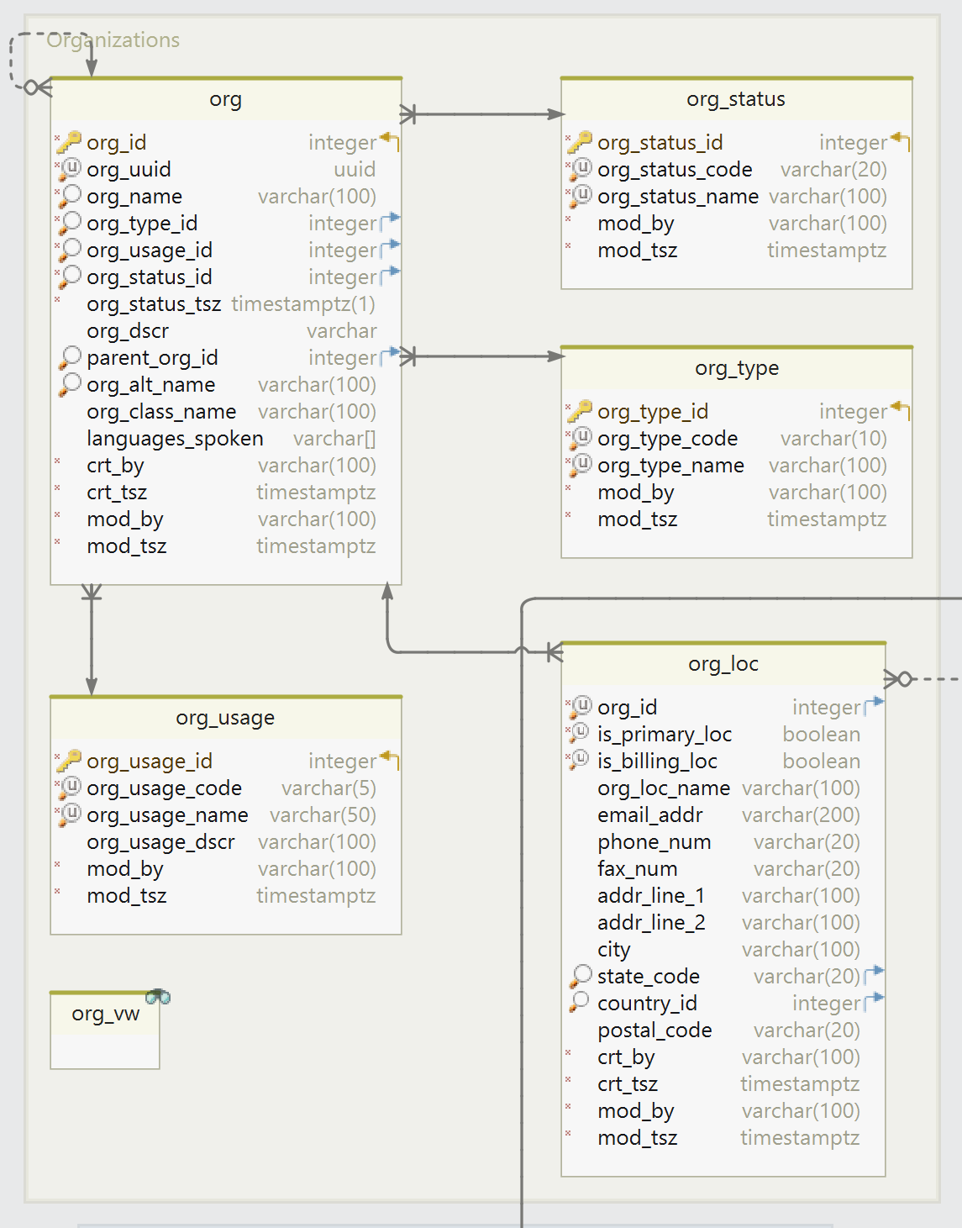
Data Modeling 101 - Relationships
How the entities are related, whether the relationship is mandatory or optional, and whether you could have more than one entity in a relationship to another entity.
One-to-one
One-to-many
Many-to-many
https://www.vertabelo.com/blog/technical-articles/n-ary-relationship-types
Notes:
As a data modeler, it is your job to discover how the entities are related, whether the relationship is mandatory or optional, and whether you could have more than one entity in a relationship to another entity.
Relationships will be one-to-one (attributive), one-to-many (attributive), or many-to-many (associative).
Once the model is implemented in an RDBMS engine, a relationship between entities is enforced by storing the primary key of one entity as a "pointer" or foreign key in the table of another entity.
Would anyone like a deeper dive into the relationship types?

Slide 13
Data Modeling 101 - Inheritance
If you model a generic entity that can hold multiple types of very similar entities that only differ by a few attributes on each: identity, item, org
Or
You model a giant, “polymorphic” entity with a type attribute, and lots of optional attributes that only apply to certain types but not others
You might benefit from inheritance: applying supertype and subtype
https://vertabelo.com/blog/inheritance-in-a-relational-database

Slide 14
Data Modeling 101 - Cardinality & Optionality
Determine how many of any given thing there can be, be it an entity, attribute or side of a relationship
Determine whether the attribute or relationship is mandatory or optional
  If the attribute is mandatory, place a NOT NULL constraint on the column
  If the relationship to a child table is mandatory, the parent ID column on the child table should be constrained as NOT NULL
Notes:
Cardinality is a fancy-sounding word that makes you appear to be someone who needs to use big words to make up for insecurities.
Cardinality is a mathematical term. It means "the number of elements in a set or other grouping, as a property of that grouping." In other words, it means “how many.”
Along with the basics mentioned above, one of your primary responsibilities is to determine how many of any given thing there can be, be it an entity, attribute or side of a relationship.
Can there be none? Can there only ever be one? The business says there will never be more than X. Are they absolutely sure? Or does the relationship need to support an indeterminate quantity of the child entity related to the parent entity?
As mentioned earlier, if you determine that there can or might be more than one of a given attribute, it cannot remain on the parent entity. It should be broken off and placed into its own entity and foreign keyed to the parent.
Never succumb to the temptation to place multiple values for an attribute in a delimited list in a single column. A common example is contact details. It is best to not allow multiple phone numbers, addresses, or emails to be stored on the parent contact row. Create a one-to-many child table instead for the multiple emails, another one for the multiple physical addresses, etc.
Next, determine whether the attribute or relationship is mandatory or optional. If the attribute is mandatory, place a NOT NULL constraint on the column.
If the relationship to a child table is mandatory, the parent ID column on the child table should be constrained as NOT NULL, otherwise leave it nullable.

Slide 15
Data Modeling 101 - Keys, Constraints, Defaults
For each entity, determine the column(s) that represent a unique instance. This becomes the natural key.
  If natural key can change, add a surrogate key (see http://www.agiledata.org/essays/keys.html)
Determine which column values should be governed by a check constraint to ensure only valid values are accepted.
  NOT NULL constraints were already found during the Optionality exercise.
  Foreign key constraints are found during the Relationships exercise.
For each attribute, determine if the database should fill in a default value during row creation if the application does not pass a value in for it
Notes:
An attribute that uniquely identifies an instance of an entity is known as its natural key. Natural keys for a person are Drivers License Number, Email Address and Social Security Number. The natural key for an automobile is its Vehicle Identification Number.
The key can be used to quickly find the matching row, and refer to that row from a child table. However, the natural key is usually mutable. If the key ever changes, you do not want to update the 20 billion child records dependent on that key. Natural keys should be specified using unique key constraints (UK).
If the natural key could conceivably ever change, add a unique numeric column to the table to be the "surrogate", aka primary key constraint (PK) for the row.
For most entities, the presence of more than one natural unique key generally is a modeling error. However, lookup tables often have more than one natural unique key, i.e. code, name, and display_name.
Check Constraints
Each application will have many data rules. A banking application, for example, will protect its customers' accounts from bad people and hackers by limiting withdrawals to no more than $300 from an ATM, or more than $2500 from a teller in a given day. It will require collaboration and good judgment between you, engineering and product to determine if the data rules are enforced in the front-end UI, the middle tier business logic, or the back-end database...or a combination of two or more of those!

Slide 16
Data Modeling 101 - Normalization
Each entity should describe a single object or concept. (1NF)
Each attribute should contain a single value. (1NF)
Every value in an attribute should be of the same type. (1NF)
Each entity should have at least one attribute, or combination of attributes, that uniquely identify a row. (~1NF)
Repeating attributes should be broken off into a child table, with a foreign key column pointing back to the parent table. (~1NF)
Each attribute should apply only to the entity on which it is found.
(~2NF*, 3NF)
Each piece of data should only be stored in one place. (~BCNF)
Notes:
Normalization is the process of eliminating most of the redundancy from the entities and attributes identified earlier.
Most training on relational design cite the pioneers E.F. Codd and C.J. Date. They typically instruct the reader in Codd's original definitions for each normal form. As Codd and Date's writings are based in mathematics, set-theory and provable algorithms, the reader is often left scratching their head. Although you might find it worthwhile to memorize the definition of each normal form, I do not. The business and end users only care that their data is stored and handled well, and returned to them accurately when they need it. A relational database's reason for being is to answer questions about data where the questions were not known at design time. This is known as ad-hoc querying. In order to achieve those goals easily, we must meet each of the following standards to arrive at a normalized model that eliminates redundancy and inconsistency in a relational database
*The official definition of 2nd normal form is "It does not have any non-prime attribute that is functionally dependent on any proper subset of any candidate key of the relation." Now you know why I'm paraphrasing Codd's specifications.
https://www.essentialsql.com/get-ready-to-learn-sql-database-normalization-explained-in-simple-english
https://codingsight.com/database-normalization-a-primer
https://vertabelo.com/blog/database-normalization-primer-how-and-how-not-to-decompose-relations/
https://holowczak.com/database-normalization
https://www.guru99.com/database-normalization.html

Slide 17
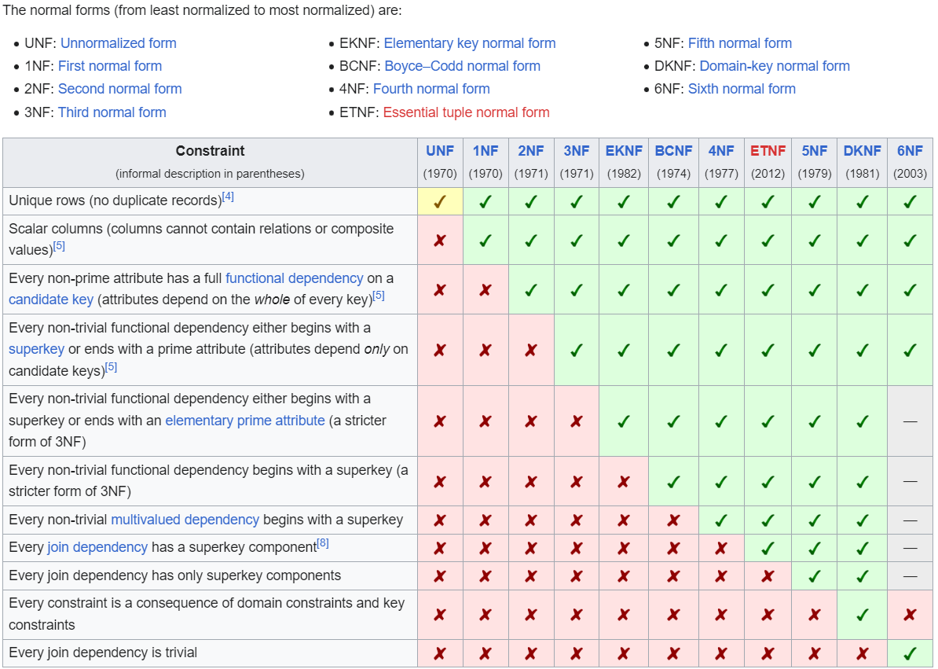
Data Modeling 101 - Normal Forms
Notes:
Here is a matrix from the Wikipedia article linked in this speaker note, which succinctly shows all the known normal forms, their names, and which rules each contains. 3NF and a little of BCNF is really all you need to design a robust, clean model you can be proud of.
https://en.wikipedia.org/wiki/Database_normalization

Slide 18
Data Modeling 101 - Model Diagrams
Conceptual/Subject Area
Logical
Physical
Notes:
Humans communicate, learn and retain information better when it is accompanied by audio, video, pictures and stories. And yet knowing that, I included almost none of that into this presentation or it would have made it twice as long. Whoops.
At a previous employer, where we introduced a model-first culture, whenever a new manager hired on, the first thing they would ask for were the entity-relationship diagrams (ERDs). ERDs don’t model process or data flow, but they were awesome at helping them quickly grasp the scope of a system or domain. Even stakeholders, CXO's and end users can understand the main parts and details of a software system when given an ERD. It is just a wonderful tool.
There are three basic types of data model diagrams…

Slide 19
Conceptual Model
Person
Employee
Provider
Patient
Prescription
Appointment
Diagnosis
Major concepts and core business areas, with minimal lines showing association, dependence or flow
Notes:
Some modeling gurus call this the Domain Model, Core Concept Model or Subject Area Model. The conceptual model embodies the essence of the company, the core, essential things that everyone talks about, all the time. If you took these things away, the business wouldn’t exist. Take for example this truncated conceptual model of a health provider’s office management software.
As you speak with business people, attend project kickoff, look at legacy systems and read use cases and requirements, you will get a good idea what the core, critical terms and concepts are around which the system revolves. These are the items that belong on a conceptual model.
The conceptual model is optional. It only takes a few minutes to pull together and can be invaluable when speaking with non-technical stakeholders and other departments about your system’s key concepts and datastores.

Slide 20
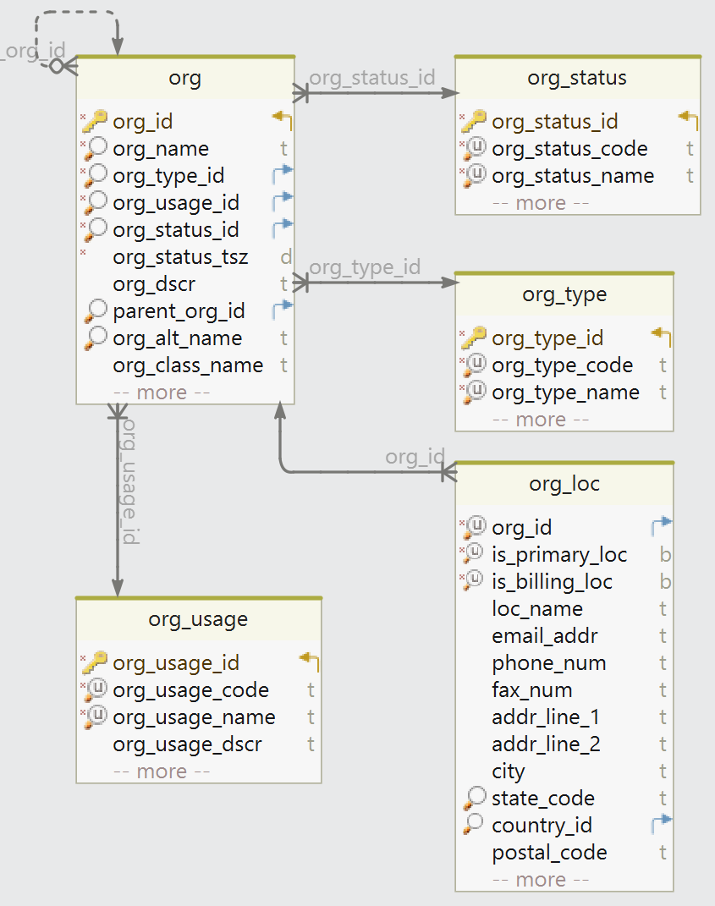
Logical Model
Business nouns and adjectives. Keys, optionality and relationships defined.
Notes:
Logical models are typically never updated after the physical model has been created, so logical models are optional. Logical models are a waste of time when attempting to reverse engineer an existing system.
But when designing new systems, a logical model will be the natural outcome of initial discovery and requirements gathering. Designing a logical model can be helpful for discussions with management, product people, and other IT-savvy employees who aren't the developers.
The logical data model should be database-agnostic, able to be forward-engineered into any relational database engine.

Slide 21
Data Modeling 101 - Indexes, Audit, Denorm
Defining primary key and natural key uniqueness constraints automatically generates a supporting index
Each foreign key column on a child table should have an index to support lookups, joins, and parent deletions. FK indexes are not automatic.
Columns that will be used frequently in WHERE clauses should be indexed (sometimes individually, sometimes together in a composite index)
Are audit columns or historical tables desired to track creation, updates and deletions?
Denormalize only to meet performance goals
Notes:
Before generating the physical database DDL scripts, we still need to address the performance of known queries, filters, and joins; as well as audit, historical record keeping, and data retention concerns.
One thing you should know that is sadly not common knowledge is that … (go through bullets)

Slide 22
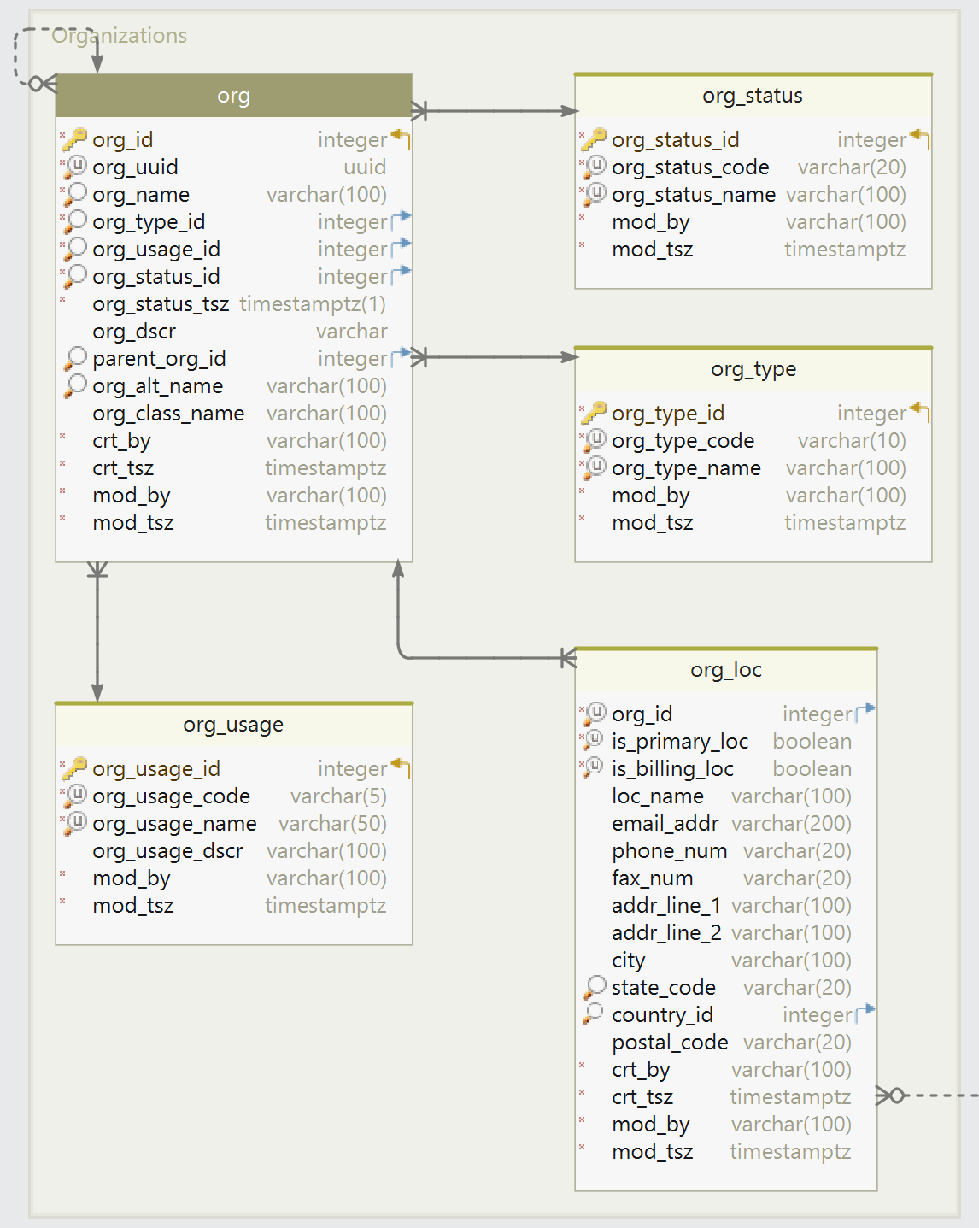
Physical Model
Additions, changes and compromises to meet database features/limitations, and application goals: surrogate keys, audit columns, indexes, materialized views, etc.
Notes:
A physical data model is the sort you will use most often in your daily work as someone in IT.
To a logical model, you would make database-specific, security-specific, audit/historical and performance-specific additions.

Slide 23
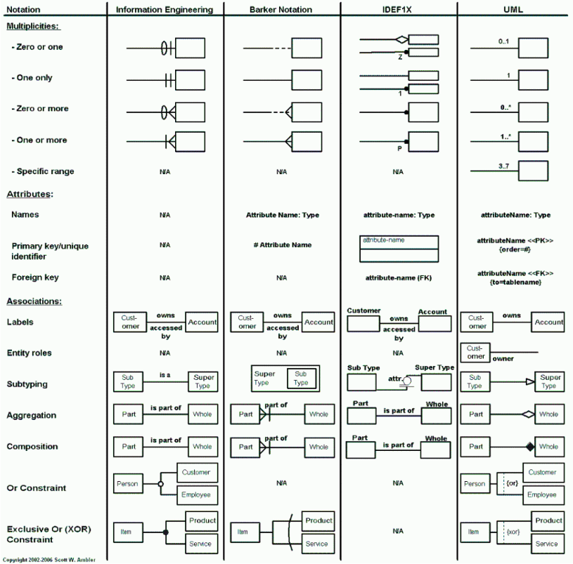
Data Modeling 101 - Diagram Notation
This side-by-side comparison is useful to see the differences between the four major notations.
Every shop I’ve worked in has preferred IE notation, aka “crow’s foot”
Diagram from Scott Ambler’s DataModeling101 page (agiledata.org)
Notes:
There are at least five different types of ER diagram notation that I'm aware of. Of these, my favorite for expressiveness and ease of understanding is the IE notation, otherwise known as "crow's foot" notation.
This image is a comparison of IE, Barker, IDEFX1, and UML side-by-side.
Most data modeling tools default to IE. This is also the most common notation used in college courses on RDBMS design. If your tool is not using it, please change the notation setting to IE.

Slide 24
Data Modeling 101 - Documentation & Naming
Capture everything currently known about the entities and attributes in table and column comments, e.g. COMMENT ON TABLE mytab IS ‘...’;
Naming Principles:
  Establish and stick to a Logical and Physical Model naming standard
    If the convention clashes with legacy, best to be consistent, unless legacy was terrible
  Every name should be no longer than necessary to be intuitive and self-describing
  A generic entity name is acceptable: person, object, event, status, etc
  A generic attribute name, like id, code, text, type, status, etc., is heavily discouraged
  Group related items with a common prefix
  Use a standard set of suffixes to denote the attribute’s data type. Be consistent.
  Attribute names should represent the positive, active case
Notes:
We’ve already talked about the importance of getting to know your data. Now it is time to get it out of the sticky notes, notebooks, legal pads, and Word docs and into the database itself, where it stands a chance of sticking around permanently and remaining relevant.
As you are modeling your attributes, enter what you and your tribe know about each piece of data into the modeling tool. Later this will transfer into the physical model when it is generated, into the DDL scripts when they are generated, and into the database as table and column comments, where they can be read by developers for years to come, and picked up by data governance and cataloging tools. If you don’t use a modeling tool, then write the table and column comments into the DDL script by hand. They are that important.
To some, conformance to a naming standard seems inconsequential.
However, a solid naming scheme has been proven to heavily reduce maintenance and enhancement costs.
A good standard also prevents namespace collisions, enables automation, and provides the ability to quickly recognize important attributes and context for a given object.
Naming within a logical model is straightforward: Name everything as it truly is, as it is referred to by the business, fully spelled out, each word starting with a capital letter.
Naming within a physical model, targeted for a specific database, requires more thought to fit within the database’s length limitations and avoid clashes with known keywords and reserved words. I wrote my first naming guide for relational database back in 1997, and have been tweaking it ever since. Find the full thing for Postgres in my recent dbsherpa.com blog post. It includes a one-page matrix of database objects, the naming convention for each, and name examples. You can print this out, tape it to your wall, and refer to it until it becomes second nature. I’ve distilled that large document into a handful of guiding principles for naming… (go over the bullets)

Slide 25
Data Modeling 101 - Review and Versioning
The model should be reviewed by peers, the application team, the business analyst, domain or subject expert.
Takes notes, incorporate changes and refactor the model until it is solid and “feels right”
Once approved, check into your SCC system
Notes:
Finally, have your model reviewed by a peer, or the end user to see if you got it right.
Deploy your DDL scripts to the database, fill it with real data, or test data that mimics the real world, and test away
Iterate and improve until the model is good
Check in revisions so you have a record of every modification to the database, who made it, and why. Ideally include a reference or link to your change management system.

Slide 26
Data Modeling 101 - Tools
Requirements & Documentation: Atlassian Confluence, MS OneNote, Azure ADO Wiki
Modeling: Idera ER/Studio, Quest Erwin, DbSchema, Oracle SDDM
DB IDE: PL/SQL Developer, Oracle SQLdeveloper, DataGrip, DBeaver
SCC: git + GitHub
Migration/Deployment: Liquibase, Flyway
Notes:
This is a short list of the primary tools I use, or have used, for these aspects of the data modeling role.

Slide 27
Let’s Practice!

Slide 28
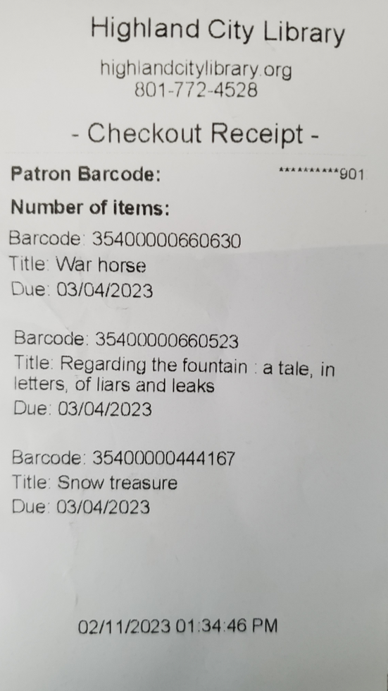
Simple Library Item Checkout Application
Have a look at the following checkout receipt and write down the entities, attributes and relationships that you foresee the system needing.
Then write down any questions that come to mind as you are teasing those out of this receipt and asking yourself if you understand everything about the needs of this system.
DO NOT PROCEED TO THE NEXT SLIDE.
ACTUALLY DO THIS EXERCISE.
Bonus: Create a conceptual model, a logical model, and a physical model before the next slide
Notes:
Let’s take a simple, real-world document, a library checkout receipt, and apply normalization and data modeling principles, to come up with a proposed conceptual, logical and physical data model that could be implemented in less than an hour to create a library checkout system.

Slide 29
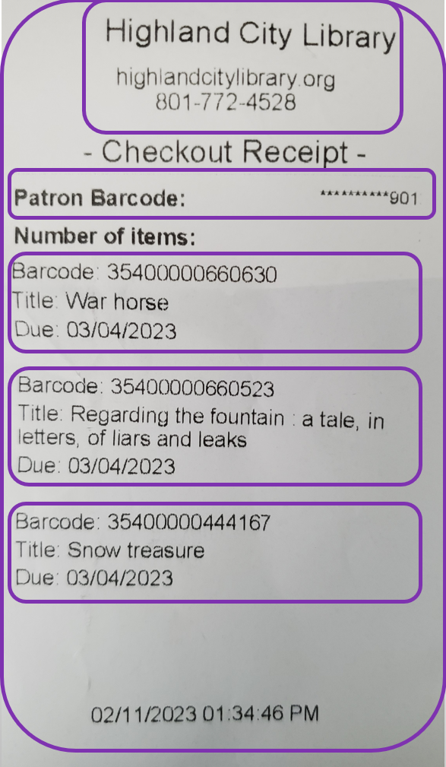
Simple Library Item Checkout Application
Entities & Attributes:
Receipt (Library, Patron Barcode, [Item], Timestamp in local TZ)
Library (Name, URL, Phone)
Patron (Barcode)
Item (Barcode, Type, Title, Due Date)
Relationships:
Library issues a card to a patron. When checking out items, patron receives a receipt. Receipt lists 1..25 items
Rules:
Books and Audiobooks are due in 3 weeks
Videos are due in 1 week
Patron may checkout a maximum of 25 total items
Questions (small sample):
Would you like to store and display the item type?
How old must a patron be to own a card?
Can the card be used at other city libraries?
Is Barcode always numeric? Can it start with 0’s? Does it have a fixed length?
Notes:
I’ve highlighted the entities in purple.
The attributes are found displayed within, or associated to each entity. Sometimes what you see in a physical example like this, or in a mockup or use-case or user-journey story, is not the full set of attributes expected by the analyst, product owner, or business subject matter expert. They are often aware of more entities that belong to the system, more attributes that are needed, or typically not displayed due to edge cases. You’ve got to dig and be great at being curious and asking questions, to be sure. If you have a sharp analyst that already does this for you, fantastic; that makes your job far easier.

Slide 30
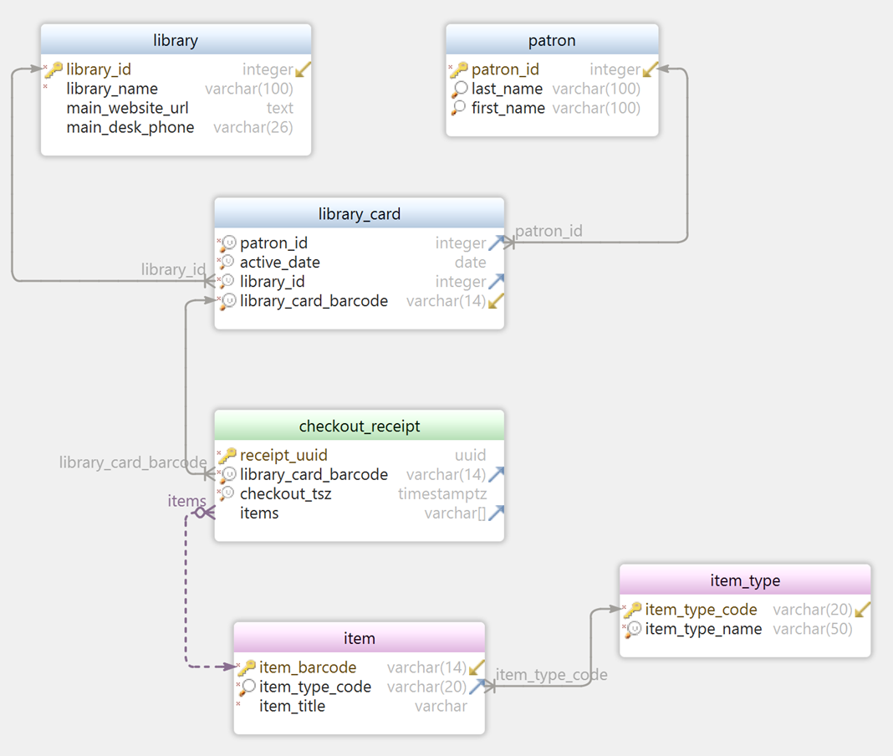
What is missing?
Do you anticipate problems with this model as you walk a patron through getting a library card and checking out a mix of items?
Notes:
Here is a first draft approach to modeling just the entities or attributes we see or anticipate. Is it good? Is it complete?
Does it handle the basic scenario of a patron presenting a card (which has already been activated as part of a different process in the library), checking out one or more items, and receiving a receipt with a due date next to each item?
(one issue is the items array is just a list of barcodes. If you want to search for a particular title that is checked out, every items array across the database has to be opened. Plus because it’s an array, there is no way to store additional, useful attributes about the item in the checkout transaction, for example, no due date)

Slide 31
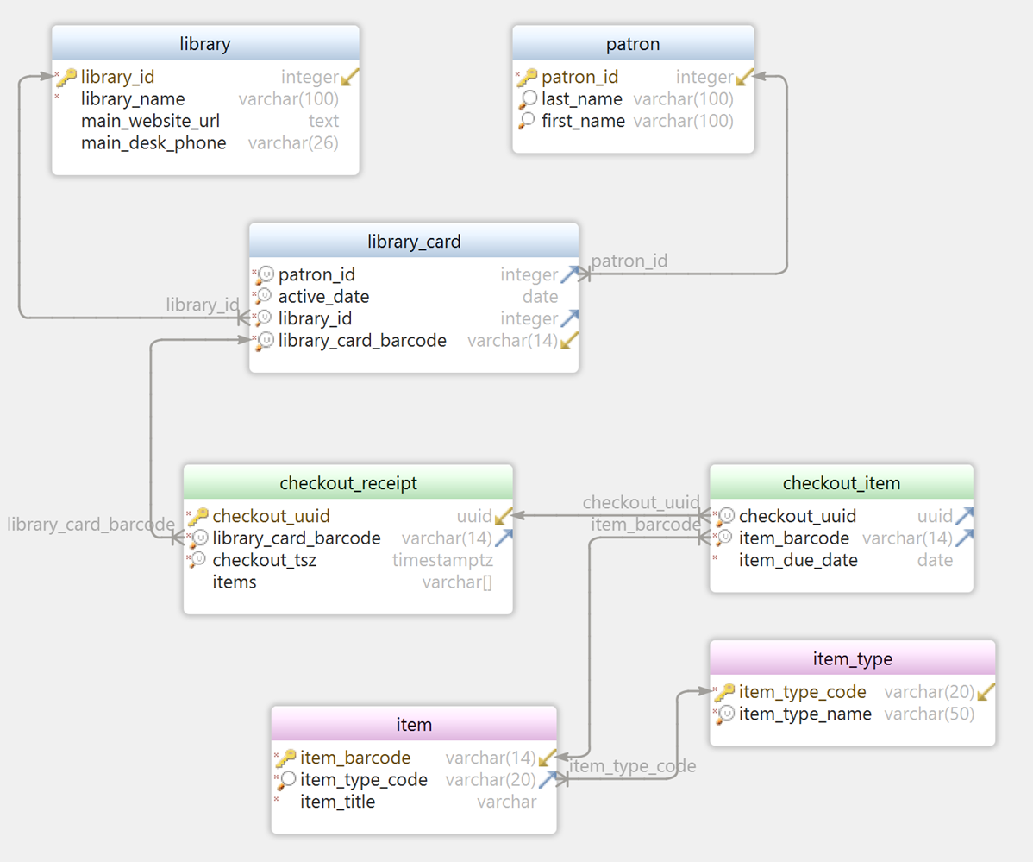
What about this model?
Due dates are now handled cleanly.
Searching for items in currently checked out inventory is easy.
What holes can you still see?
Notes:
What about this draft, is there more we could or should be asking?

Slide 32
Guiding Principles
Notes:
Along with the basics of data modeling, I felt it of the utmost importance to share a handful of guiding principles I’ve learned deeply, and at great cost over the previous three decades.
Following these guiding principles makes all the difference in improving the maturity of your shop’s modeling efforts and database change management.

Slide 33

Guiding Principles
Know Your Data
Notes:
First: Know Your Data.
This is the most important of the five principles. If you are curious about all aspects of the data you are working with, for which you are designing storage and retrieval mechanisms, you will become indispensable. You will be amazing at modeling, database development, queries and performance tuning.
A good engineer and architect is not content focusing on their little keyhole view of the system landscape. They want to know everything about the system they are a part of. And when it comes to the entity presently being designed, they want to know every nuance about every attribute.
This thirst for knowledge about the data under your stewardship — and how it plays with the data in other systems where you are not the steward — is critical to your team and organization success, both short term and long term.

Slide 34
Questions for Entities and Domains
Will that report be paginated, or will you want the entire query results at once?
How many records do you initially anticipate in the table behind that screen?
How much will that grow per day/month/year?
Which fields identify a unique instance of this record?
How long does the customer/business anticipate the data should stay online and accessible? Once the retention period is past, could the data be deleted, or must it be soft-deleted (inactivated), put in historical tables, or moved to a near-line storage medium?
Could this app and its end users tolerate eventual consistency, or do they demand immediate accuracy?
What questions and queries are anticipated on this data the app will store?
Is the creation and last modification user and timestamp sufficient, or do we need to record metadata and before/after values for every change?
What response times are acceptable for this event/action/report/page request?
Have you identified enough detail about the entity to satisfy requirements? (think of a used car app where only the VIN, miles, condition, make, model and year need to be known to post, but there might be far more optional and required fields to make the app usable)
Are there legal, financial or privacy concerns?
Notes:
Here is a sample of the sorts of questions you should be asking about the entities and domains managed by the system you are designing. Take a second to read a few of them, and then we’ll move on. You can refer to them later with your copy of this presentation.
(let them read…)
These sample questions only scratch the surface. There are many appropriate questions that a curious data designer should ask. Knowing your data will help you make good design decisions now; and later, make you indispensable as a query wizard, business leader, and performance tuner.

Slide 35
Questions for Attributes
What is the minimum/maximum amount of characters allowed in that field?
Is that field optional or required?
Is it required only upon certain condition(s)?
Should it be empty upon certain condition(s)?
Should the data be normalized to uppercase on the backend (think addresses), or stored exactly as the user typed it in?
What are the allowable values for that radio/checkbox/listbox field?
Will the users enter the data manually, or is the field fully controlled by the system?
Is there a required format, or set of allowable formats, for the values in the field that should be checked by the client, the database, or both?
Will that textbox text ever be searched or mined, or will it just be displayed for other users to read?
How many digits of precision are required for that number?
Is date sufficient, or should time be recorded as well?
Will that field/label need to support other languages?
Does that field need to be masked during entry, or encrypted at rest or in transit across the network?
Notes:
Here is a sample of the sorts of questions you should be asking about every attribute on every entity. Yes, this takes time to do well. This is where you become invaluable and earn your paycheck.

Slide 36
Questions for Relationships and Rules
What are the business rules surrounding how many children or parents are allowed?
Is the relationship optional or required? Is the required…ness dependent on certain conditions?
Is the relationship transferrable? (can it move from one owner to another)
Where the relationship is recursive (for example employees managed by senior employees), are there business rules about when the field containing the FK value can be filled, or when it should be empty? (for example an employee may not be supervisor of themselves)
Notes:
Here is a sample of the sorts of questions you should be asking about the relationships between entities and business rules that pertain to them or their attribute values.

Slide 37

Guiding Principles
Model First
Model Well
Notes:
The second principle encourages the data professional, and the organization they lead or inspire, to model first, and make sure to model well.

Slide 38
Guiding Principles - Model First
Model first means new and changed data structures begin life in the modeling tool, upon a versioned model file. This habit allows a team to:
generate and validate data glossaries, dictionaries, and catalogs
build and maintain slick diagrams and documentation from the modeling tool for publishing, reference and discussions
compare data models from prior releases to see changes over time
generate data model change release notes
re-use common entity, attribute, and domain definitions across models in the same enterprise
perform cross-system dependency analysis
drive a data structure change request to production in 10 minutes (data management can be Agile too)
…and more
Notes:
Model first is a mindset that applies to database change management.
It means new data structures and changed data structures all begin in the data modeling tool upon the versioned data model file, not manually altered in the database or in hand-crafted DDL scripts.
In an ideal world, all database changes would begin with the data architect for your project. These changes would be entered in the modeling tool, validated against existing standards, committed to the enterprise data model repository, and then forward engineered into DDL scripts. The DDL can then be tested in development, and committed to the Flyway or Liquibase folder for flawless release to higher environments.
If all model changes begin in the modeling tool, are versioned, and managed well in their deployment up to Prod, it enables all sorts of goodness…
To some “model first” sounds like a fairy tail, just an unattainable fable. But I have built and lived in a model-first culture twice before, and it was awesome! It is do-able, and it is worth every effort to get there.

Slide 39


Guiding Principles - Model Well
Model well means to follow basic relational design principles and to not compromise or accept technical debt in this area.
Notes:
Model well means to follow basic relational design principles and to not compromise or accept technical debt just to meet the immediate demands of deadlines and developers who are used to moving fast and sloppy with data.
In essence, “do it right the first time.”
It is just not worth it taking shortcuts on the system’s foundation for convenience or artificial timelines.
If the data foundation starts out compromised, it isn’t even suitable for the initial phases of the project, let alone enterprise-grade usage, expansion and growth of future phases. A poor data foundation will cause nothing but increasing pain and money as it ages.
Here are some structures where the foundation wasn’t properly prepared. The same WILL happen with software systems built hastily on a poor data layer.
It is far less costly to experiment, cut corners, and take risks with the exterior treatments, the user-friendly façade of a system. NEVER experiment or cut corners with the data foundation.
On the other hand, if you start with a solid, clean data model as your foundation, it is easy to build, re-build, extend and re-model on top of it later when needed.

Slide 40
Guiding Principles - Model Well
Modeling well also means industry standards and best practices are followed.
Relational:
Model to 3rd normal form
Generate physical from logical, adding indexes, surrogate keys, constraints, historical tables, and audit columns/tables.
Review and test the model
  Add views to make the model friendlier to users and developers
  Add materialized views and sync mechanisms to make the model perform better
Notes:
Model Well also means you follow best practices when modeling. For relational databases, which are the right choice for about 60 to 80% of your systems, depending on the industry, these best practices include:
Take the logical model to 3rd normal formal. Apologies that we haven’t talked about normalization yet. The third level of normalization (3NF or BCNF) is usually sufficient for a clean model. Less than 3NF is lazy and reckless. More than that (4NF, 5NF, 6NF) runs into the law of diminishing returns, and results in models that are far too complex.
Once the model is clean and the database platform has been selected, proceed to the physical model, adding indexes, surrogate keys, constraints, historical tables and audit columns. These items support and optimize data queries, processing, and maintenance. Continue to avoid redundancy as much as possible.
After your base data model is solid, reviewed and tested, use it.
If the model is complex enough that it is difficult for developers to write joins, do the joins for them: write views that pre-join the harder parts of the model. Help them with their embedded and generated SQL
If the model is too slow for performance requirements, and other options have been exhausted (optimizing hardware, memory, database configuration, statistics, SQL tuning, etc.) THEN consider denormalization. The best denormalization options are those where the database automatically keeps the duplicates in sync for you, in real time, or periodic refreshes if real-time is not required. Oracle’s materialized views with mv logs and refresh on commit are a good example of auto-managed denormalizations. If you are going to duplicate data to improve performance, ensure that robust mechanisms are used to keep the duplicates immediately or eventually up-to-date.

Slide 41
Guiding Principles - Model Well
Modeling well also implies taking ownership and caring about doing a fantastic job. If you grok the current state of the business, and anticipate where it is going, your data model is much more likely to age gracefully and support the business well into the future.
If this is not done, the data model will be a deep well of technical debt. Therefore:
Ask lots of questions to ensure requirements are complete
Capture and document that knowledge in the model
Notes:
A large part of modeling well is wrapped up in the first principle above, Know Your Data. Therefore:
Ask lots of the right questions to ensure that the business and data requirements are complete, and your model meets the needs of the system.
Capture and document all the entities, attributes, relationships, business rules and “tribal knowledge” mentioned in conversations, meetings, whiteboards, chats, emails and documents.
Collaboration spaces like OneNote, OneDrive, Teams and ADO can be used to store this documentation. However, with key players hiring on and leaving all the time, the documents will likely get stale quickly and fall into disrepair. The only place the documentation stands a slight chance of staying updated is in the object comments that are kept with the table, view, and column in the database. So ensure that every table, view and column has a full, well-written comment that is injected into the database with the COMMENT ON {table}.{column} IS ”; syntax.

Slide 42

Guiding Principles
Duplication is a Plague
Notes:
I’ve struggled with the name of this one over the years: Duplication is Evil, Duplication is a Disease, etc.. Duplication should be avoided at all costs, until you are forced to.

Slide 43
Guiding Principles - Duplication is a Plague
Each unique fact should not be found more than once in the database.
“Every piece of knowledge must have a single, unambiguous, authoritative representation within a system.” - Hunt & Thomas
The primary enemy of consistency and accuracy is duplication.
Avoid duplicating entities and attributes at all costs…until you are forced to duplicate.
  If you must duplicate, do it well and ensure the copies are kept in synch with the master.
Notes:
Duplication curses you to unending headaches… unless you have very robust self-healing, self-reporting, automated mechanisms to keep the various copies in sync with the master record.
Each unique fact should not be found more than once in the database. Hunt and Thomas, the famed duo who wrote The Pragmatic Programmer, tell us “Every piece of knowledge must have a single, unambiguous, authoritative representation within a system.” So even the venerable “DRY” principle of software engineering supports this principle of avoiding duplication. If you wouldn’t repeat an algorithm five times in a block of code, don’t repeat things in the database either.
As I write this at home, there are three digital and analog clocks within view.
Every one of them is showing me a different time! Immediately I distrust all of them and have to check my phone, which talks to a more trusted network-connected master system. In essence the clocks in my home have become unreliable decorations, almost useless approximations of the truth.
When business users encounter inconsistency in the data you manage for them, the same thing happens. If not caught in time, account and business-ending decisions can be made. Goodwill and trust are then lost in you and your data. This trust is hard to regain.
The primary enemy of consistency and accuracy is duplication.
Duplicating a piece of data increases the points of failure. By failure I mean the very real possibility of data getting created, updated or removed in one place, but not in another. This likelihood increases as time passes, systems accumulate layers, and tribal memory is lost.
This topic deserves its own white paper. We could discuss scores of examples of well-meaning duplication that ended badly, examples I’ve witnessed in the last 25 years, and that was on fairly clean and well-designed systems!
Avoid duplicating entities and attributes at all costs…until you are forced to duplicate. If you must duplicate, do it well and ensure the copies are kept in synch with the master.

Slide 44

Guiding Principles
Name Things Well
Notes:
The fourth principle is make sure to take your time to Name Things Well: tables, columns, views, stored procedures, parameters, variables, tablespaces, etc.

Slide 45
Guiding Principles - Name Things Well
“There are only two hard things in Computer Science: cache invalidation and naming things.” - Phil Karlton, VP of Netscape
“Programs are meant to be read by humans and only incidentally for computers to execute.” - Donald Knuth
Notes:
Whenever I’ve spent time agonizing over the name of a entity or an attribute, I end up questioning the value of the time spent. How can something as trivial as naming something take so much time?
A well known quote from the late VP of Netscape, Phil Karlton, warns us “There are only two hard things in Computer Science: cache invalidation and naming things.” In the thick of it, giving something a good name seems trivial, but it is not.
Another famous quote by Donald Knuth helps explain why good names matter: “Programs are meant to be read by humans and only incidentally for computers to execute.”
A well-named object pays for itself many times over. A poor name might be unreadable, misleading, opaque, confusing, incomplete or even the opposite of what it actually contains. Once a database has a few handful of these, it starts to feel like you’re living in a shabby neighborhood with absentee landlords. Every time you try to explain the model to someone, you have to punctuate your explanation with caveats, warnings and apologies.
It IS worth it to name your tables and columns well, to accurately represent what they contain.
Good naming is more an art form, than a science. It requires creativity, practicality, an understanding of your database’s limitations, and a good handle on the English language.
I’d like to share a little tip that has helped me: Read the table/column comments out loud to yourself. Obviously if there is no documentation for the object you are naming, that needs to be obtained first. Once the item has been fully understood and documented, then a good name organically materializes. About once a year I’ve had to rename a column which I named poorly during the initial design. Literally every time this has happened, I found the better name hiding in the column comments. If I had simply paid better attention to the very documentation I had gathered, it would have been named right the first time around.

Slide 46

Guiding Principles
Keep it Simple
Notes:
The last principle is to strive for simplicity, which is a landmark of true expertise and elegance.

Slide 47
Guiding Principles - Keep it Simple
“Simplicity is the most difficult thing to secure in this world; it is the last limit of experience and the last effort of genius.” – George Sand
“Simplicity is prerequisite for reliability.” – Edsger Dijkstra
“If you can’t explain it to a six-year-old, you don’t understand it yourself.” – Albert Einstein
Everything should have a home.
Put things where they belong.
Reduce and re-use.
Ensure each entity, attribute, and function does one thing, and one thing well.
Notes:
(Read the quotes…)
A data model diagram and the content it depicts should be fairly easy to grasp, even by non-technical people. If you are having a hard time understanding the model, much less explaining it, or writing queries against it, the design is not done yet. Difficulty or complexity usually signifies the requirements were insufficient, the model was over-engineered, or there are modeling mistakes. With enough experience, you’ll keep refining a model until it just “feels right.” See the principle of modeling cleanly above. When a model is not clean, it looks and feels bloated, complex, cluttered. Viewing the model in a diagram is an enormous help because it can quickly show you where foreign keys or unique constraints were missed, where columns should have been NOT NULL, where circular relationships are found, etc.
Revisit and refine the model until it is simple. Over time I have found that this state is not reached until at least the fifth iteration. It takes time to do it right. If you have to invest some extra time and dollars, do it here; invest in the application’s foundation for short and long-term paybacks.

Slide 48
Bonus Principles
Notes:
These additional principles have served me well over the last two decades of data architecture and design for large and small companies

Slide 49

Bonus Principles
Protect Your Data
Unleash Your Database
Design to End Goals from Day One
Notes:
Protect Your Data
One of the primary reasons that databases exist is to protect the integrity and accuracy of critical data.
Ignoring integrity constraints is like building a supercar without dashboard, steering or brakes, leaving you with just the engine and a pretty shell. It’ll go, but be hard to steer, brake and protect the passenger.
Use foreign key constraints, ensuring only valid values are allowed in a column.
Use primary key constraints for the surrogate keys, and unique constraints on the natural keys.
Use check constraints, default values, and NOT NULL constraints.
Define the columns with the right data type and constrain the maximum length (if applicable).
Secure the data (this could be a book unto itself, so I’ll just leave this here for further expansion).
Unleash Your Database
Too many treat their database like a hole in the ground, only useful for dumping data. This is akin to purchasing a fine sports car, but never leaving 1st gear. Use the full capabilities of your database. Let your database do what it does best. There is no need for an application to write its own mechanisms to store, join, sort, cache, search, validate, or protect the data. This is the job of the database. It has been coded and optimized by hundreds of software engineers. There is no need to attempt to replicate their efforts on your own.
Of course, this is not carte blanche to use every new feature the database releases. Put new features through appropriate testing before adopting them.
Design to End Goals from Day One
Determine the security, performance, functionality, flexibility and data quality goals of your system before beginning. These things cannot be stapled onto the data model right before release. They must be the driving forces behind your design sessions from day one. Automated, round-trip, and agile development tools and processes are making late-stage changes easier, but it will still cost less to design properly the first time around.

Slide 50
Data Design Checklist
Notes:
Wherever I go, I publish a set of documents that includes the guiding principles we’ve covered today, the Data Modeling 101 course, a database object naming guide, a data design guide, a database engineering guide, and a database tuning guide.
These are big documents with lots of detail.
I have found this scares engineers off. Frankly doing relational modeling well is not that hard, and so it serves nobody to present those large documents first. Instead I give my engineers some training, and one-on-one consultations. Then I leave them on their own to design data structures for their microservices. I give them a one page checklist that they can use during and after data design, to ensure their designs will pass review. There is a hyperlink within each point in the checklist that takes them to the larger training docs if they want additional insight and nuances.
I’ve found that after about 3 to 6 months, my engineers are producing models every bit as good as I would have.
The checklist is composed of a short section of standards, another short sections of recommendations, followed by an even shorter set of considerations, things to think about before calling the model “done.”

Slide 51
Physical Model Standards
Each table, view, materialized view and column has a clear and useful explanation filled by a comment statement
Each table has a single column surrogate (primary) key constraint
Each table has a unique (natural) key constraint, unless duplicates are expected and welcomed
Each table conforms to third normal form
Each table and column name should conform to the Naming Guide
Valid value lists are kept in parent reference/lookup tables, not enums or check constraints
Tables include the four standard audit columns
Tables may not include personally identifiable or sensitive data
Downstream teams (typical DW, BI and Analytics) or data contracts have been notified of any changes being made to data, interfaces, APIs, or agreements
Parent primary key values found in child tables are protected by an explicit foreign key on the child column(s). Each foreign key constraint is supported by an index. Each foreign key column name matches its parent key column name.
Notes:
This set of standards comes from a one-page doc that I use to summarize ALL the detailed docs on design, naming and physical modeling.
A single page checklist is far easier on the eyes, psyche and morale of developers than a 93 page treatise on modeling.
In the actual checklist, each item is a hyperlink, where the new employee, or a freshman engineer, can click the link to be taken to the section in the larger instructional docs, where they can learn all the details and nuances of that checklist item.

Slide 52
Physical Naming Recommendations
Tables: Each entity (table) name is singular, not plural
Tables: Use a common prefix for related tables to create a logical grouping
Tables: Use a type suffix to designate table type*, when applicable, like AUD, HIST, TYPE, STG, etc.
DB Objects: Use a suffix to designate the object type* (i.e. FK, PK, IX, SQ, VW, MV)
Indexes: Utilize the index type suffix* to identify index attributes and implementation (i.e. unique, function-based, b-tree, brin, gin, etc.)
Constraints: If not using default constraint names, ensure the name is readable
Triggers: Utilize the type suffix* to indicate the firing events and timing
Notes:
This set of recommendations comes from page two of that same one-page doc mentioned earlier. ;-)

Slide 53
Physical Modeling Recommendations
Manually populated surrogate keys should avoid using numbering ranges or schemes
Surrogate keys should have no intrinsic business meaning
Tables should avoid columns of repeated attributes (email1, email2, email3) or array columns that hold multiple values
  Separate repeating attributes into a child table with a type indicator to distinguish between them
All SQL/DDL/migration scripts should be readable and well-formatted
(Most IDEs will have an option to auto-format DDL and DML, making this easy to achieve)

Slide 54
Physical Modeling Considerations
How much data will there be? Will size and concurrency demand a partitioning scheme to meet performance goals?
How long will it be kept?
Will old data be soft-deleted, shuffled to historical tables, archived or simply removed?
Will privileged users or reports want, or need to access soft-deleted, shuffled or archived data? How often?
How will deletions/truncations take place when pruning?

